Slide 1


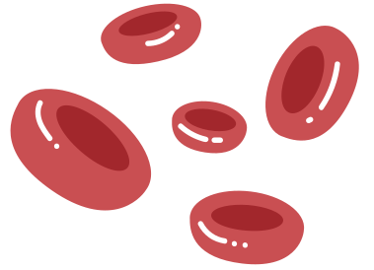


GHW Heart Failure Readmission Prediction
Data Science Model & Insights for Healthcare Intervention

Slide 2


Data Preprocessing
Handle missing values and outliers
Encode categorical variables
Check the correlation of features and drop the less important columns

Slide 3
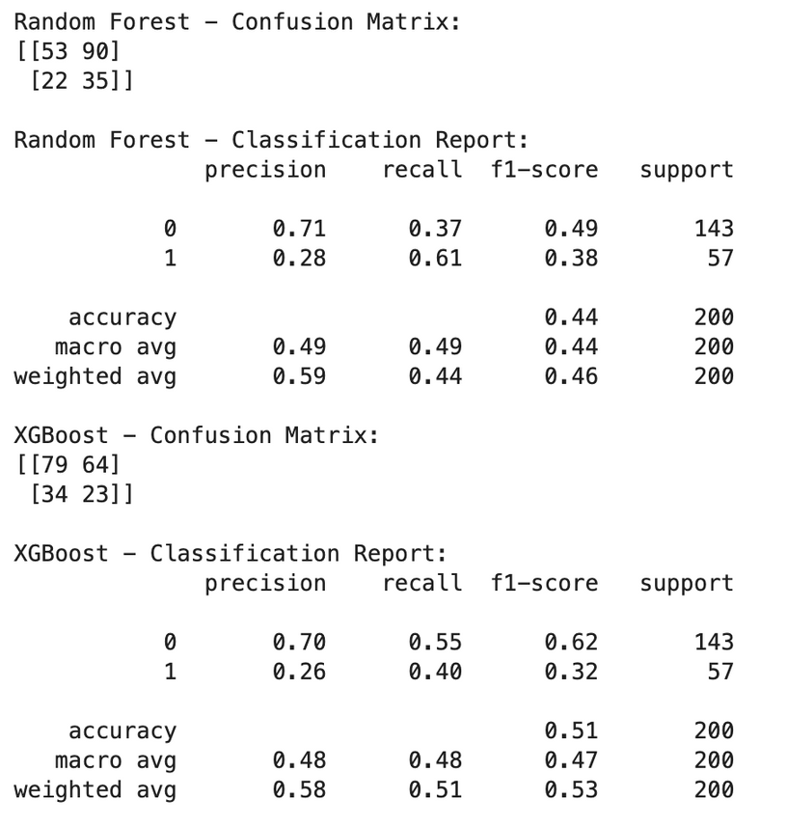

Model Performance & Justification
Models Evaluated:
Random Forest (higher Recall)
XGBoost
Why use Recall to choose model?
We want to catch as many true negative cases as possible
What kind of mistake is worse?
False Positive (predict 1, but it's actually 0)
False Negative (predict 0, but it's actually 1)
Clearly, False Negatives are more dangerous

Slide 4
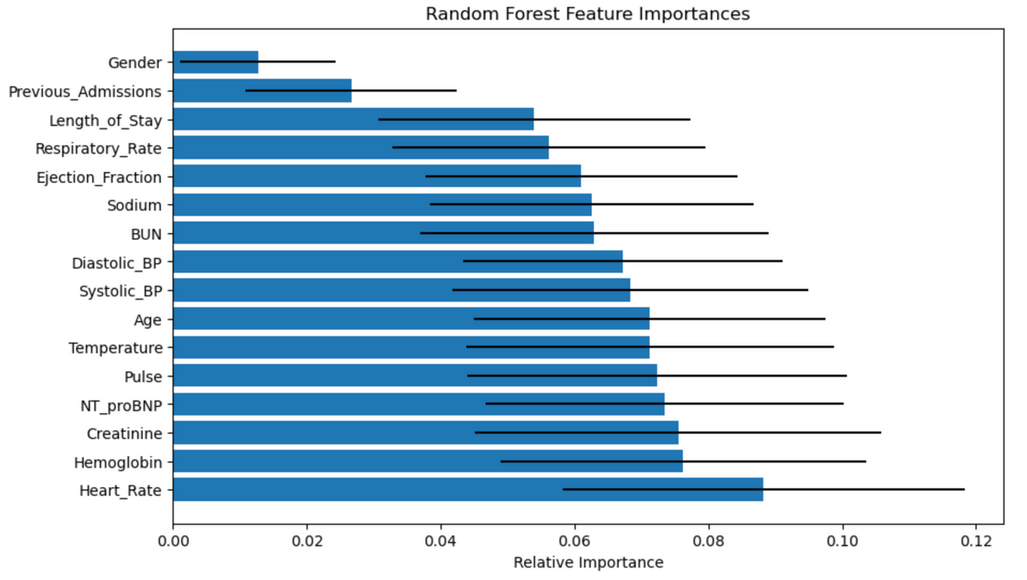
Key Findings
Top 5 most important features:
Heart_Rate
Hemoglobin
Creatinine
NT_proBNP
Pulse
Extremely low or high heart rates are not always linked with increased readmission risk.
Possibly due to more aggressive treatment or hospital stay extensions in patients with abnormal vitals.
Low hemoglobin may indicate anemia, which is common in HF and associated with worse outcomes.

Slide 5


NT_proBNP
(N-terminal pro b-type natriuretic peptide)
Represents a biomarker of heart failure; high values often indicate cardiac stress
1
The mid-range NT_proBNP (1397–2611) is associated with slightly higher readmission risk.
Range | Predicted Value
(146.999, 1397.25] | 0.28
(1397.25, 2611.0] | 0.30
(2611.0, 3704.0] | 0,28
(3704.0, 4997.0] | 0.28
2
Risk decreases again at very high levels, possibly due to more careful clinical management.

Slide 6
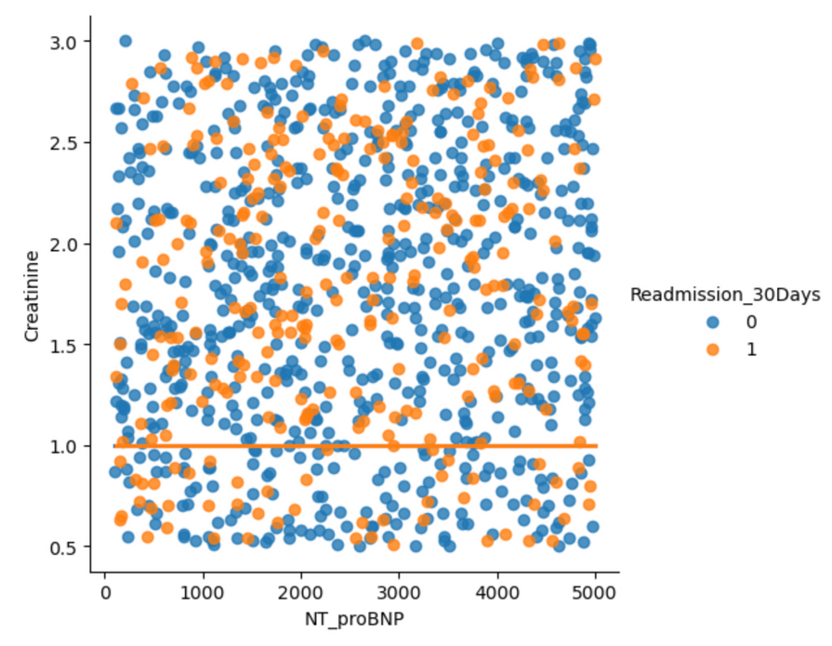
Creatinine
Reflects kidney function; high values can indicate renal impairment.
3
Orange dots (Readmitted): Spread fairly evenly, but with some concentration at high NT_proBNP and low Creatinine (<1.0).
4
Creatinine alone may not be a strong predictor unless combined with other features. Patients with high NT_proBNP and low Creatinine (<1.0) may have elevated risk, possibly due to misinterpreted kidney status (low creatinine in frail patients may not reflect healthy function).

Slide 7


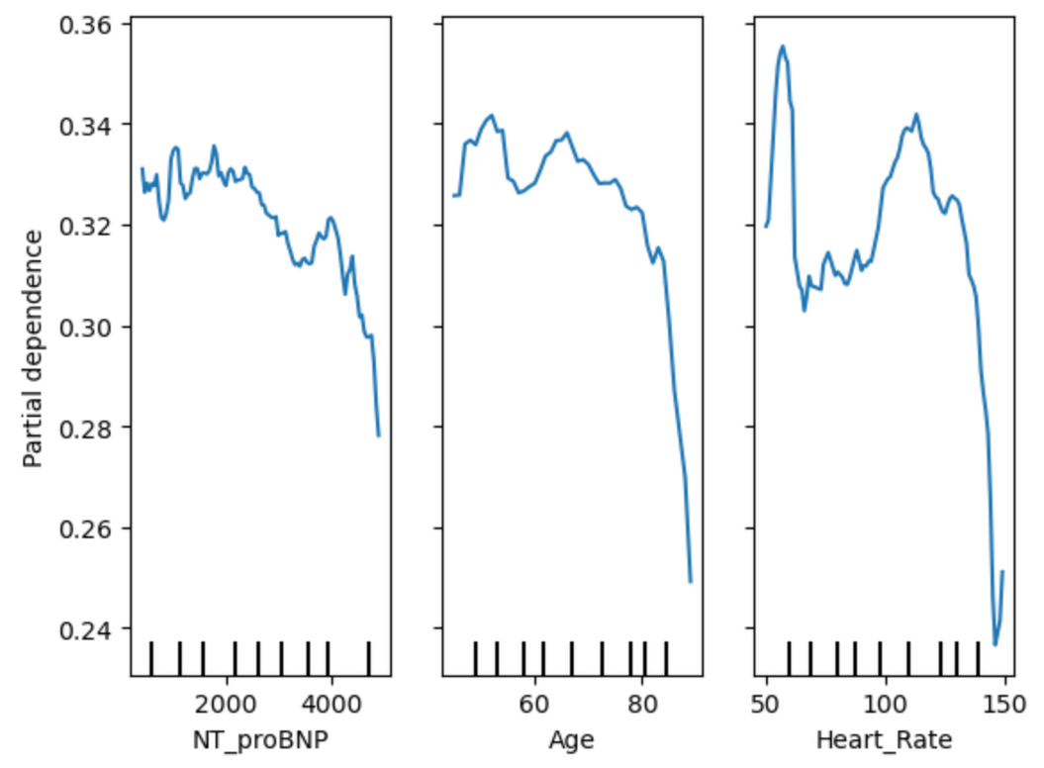
Age
Partial dependence increases slightly from age 40 to ~65–70.
Then begins to decrease after 75+, with a steep drop beyond age 85.
Middle-aged and early elderly patients (~60–75) are associated with higher readmission risk.
Patients aged 85+ may have lower readmission rates, potentially due to:
Higher in-hospital mortality (not captured as readmission),
Or more palliative-oriented care.

Slide 8
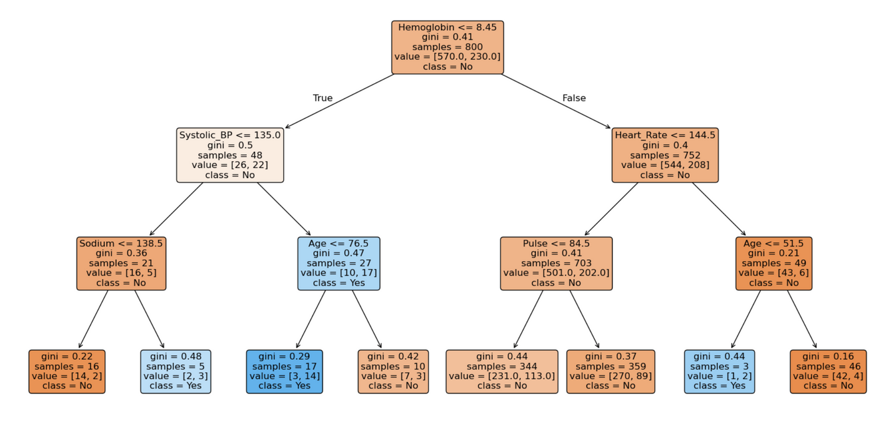
Decision
Tree
Low Hemoglobin & Age ≤ 76.5 → Higher readmission
Very low Age (<= 51.5) may signal readmission despite low gini globally
Possibly comorbidity in younger patients?

Slide 9

Recommendations
Clinical Possible Action
Flag Mid-Range NT_proBNP Patients for Closer Follow-up: Patients with NT_proBNP between ~1400–2600 show higher partial dependence.
Monitor Elderly Patients Differently Based on Age Bands: Risk peaks at 65–75, then drops after 85.
Don’t Underestimate Mid-Range Heart Rates: Patients with very low or very high heart rates get more attention—but 70–110 bpm still carries a risk.

